Slide 1
"Cooking Up the Planet: Climate Change and Alternative Lifestyles "
By
Prof. M.T. Okorodudu Fubara
Obafemi Awolowo University, Ile-Ife.

Slide 2
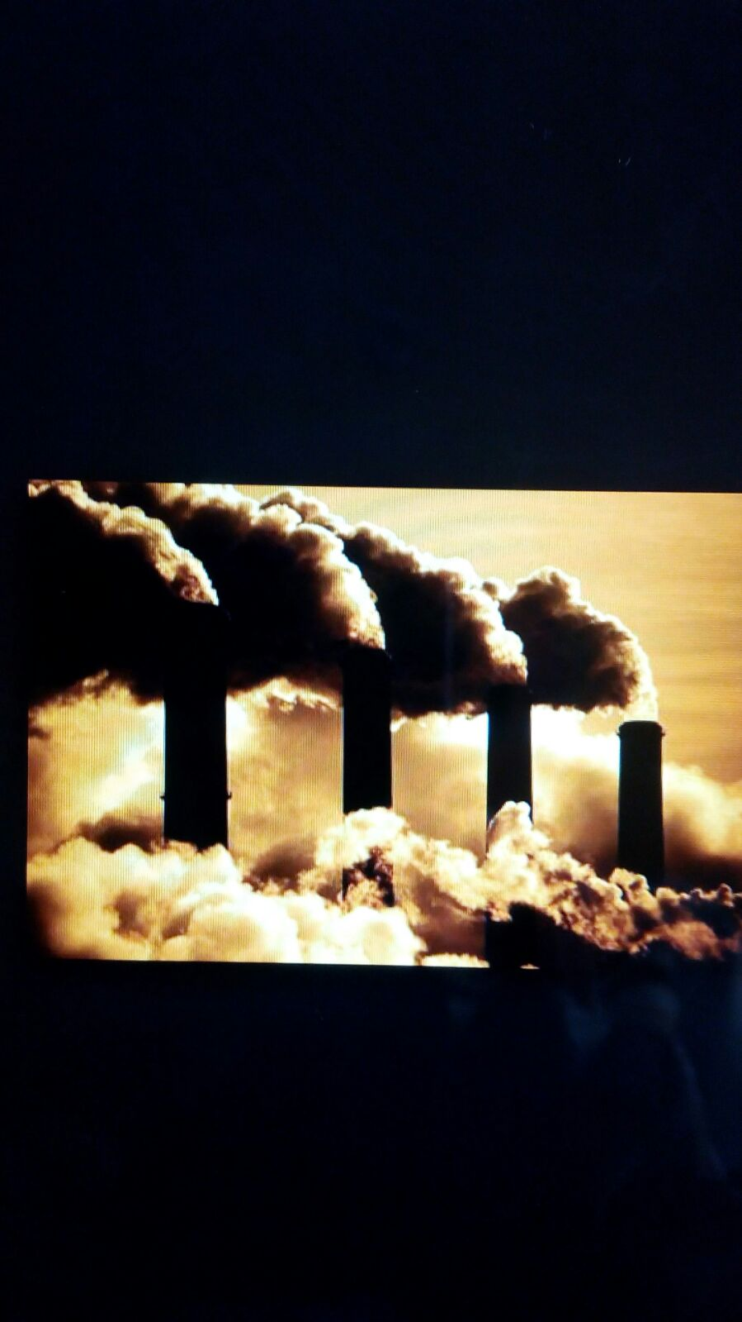

Slide 3
Presented @
Environmental Rights Action/Friends of the Earth, Nigeria
The Eighth Annual National Environment Congress (NEC)
Theme: “Extractives and Energy Transition: Roadmap for Zero-Carbon Development”
November 8 - 11, 2015
Presidential Hotel, Port Harcourt

Slide 4
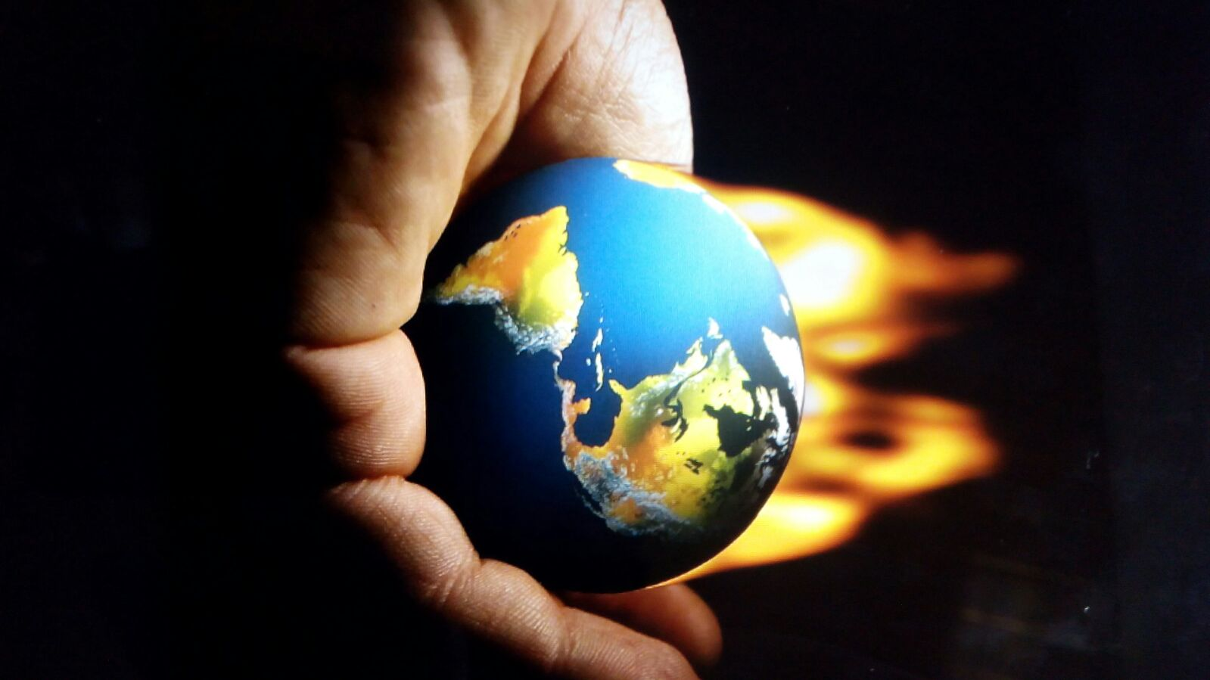

Slide 5
Preamble.... Pope Francis
The Planet 'is like a sister with whom we share our life...a beautiful mother who opens her arms to embrace us...'
Encyclical letter, 'LAUDATO SI'
'....the earth (sic) burdened and laid waste, is among the most abandoned and maltreated of our poor, she "groans in travail" (Rm. 8:22)....'

Slide 6
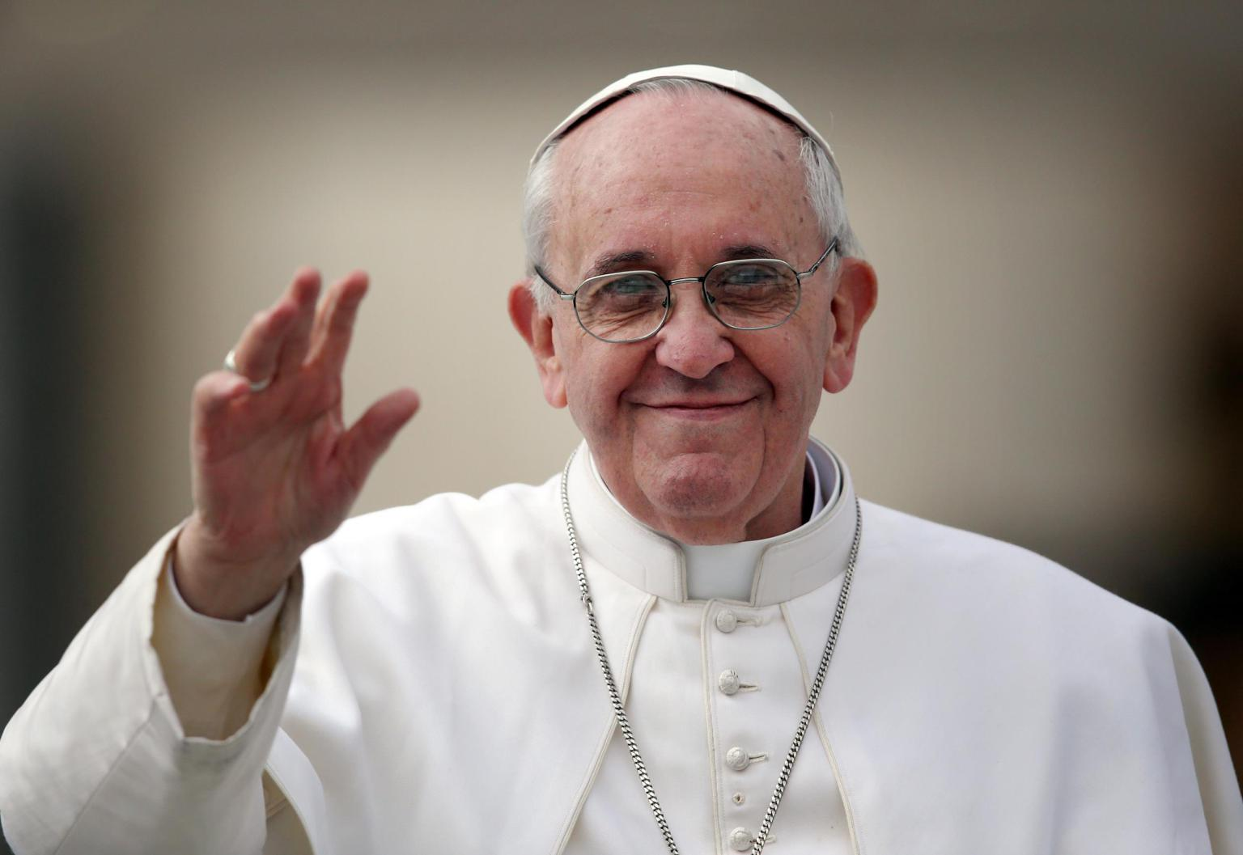

Slide 7
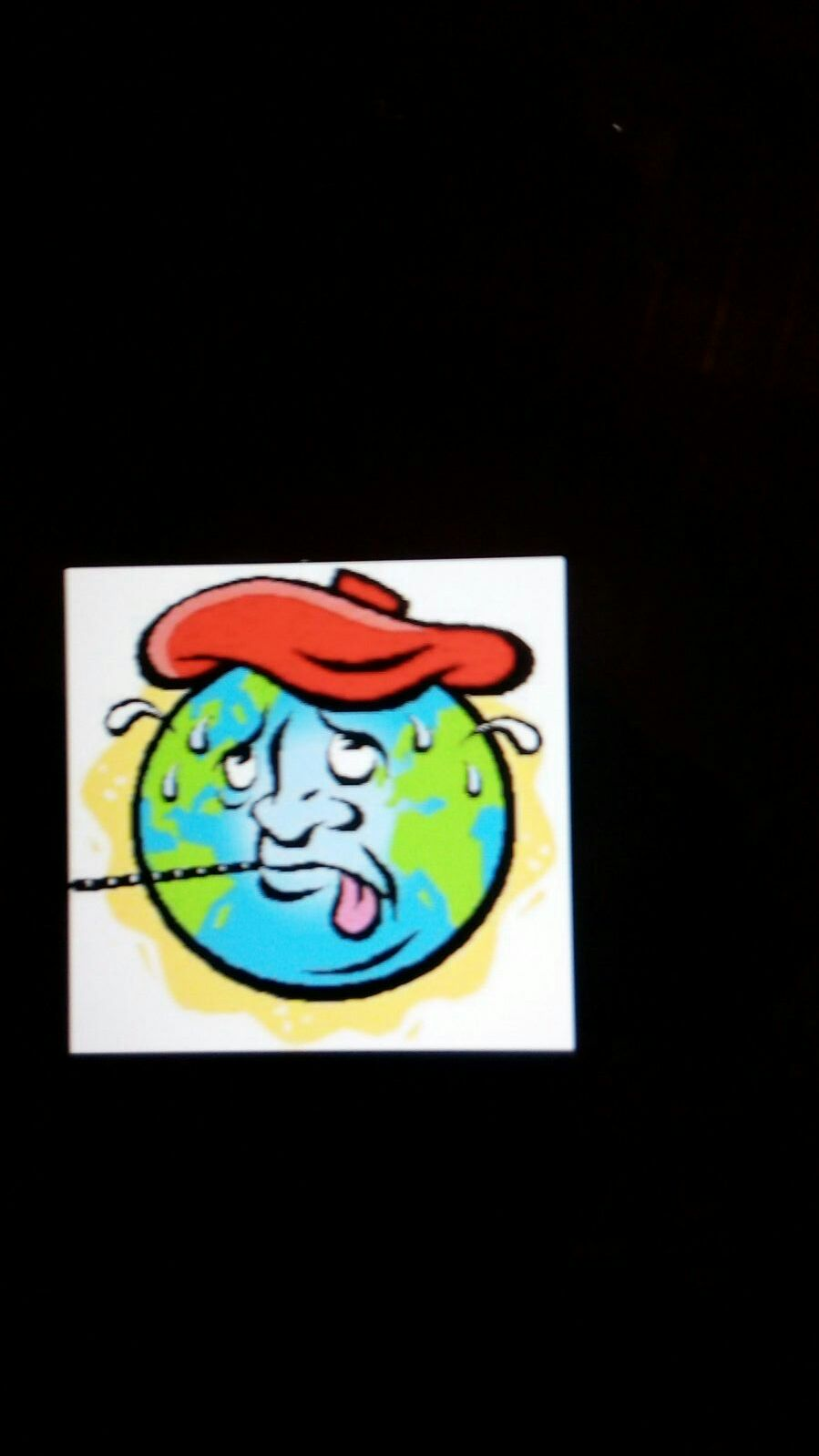

Slide 8
Pope Francis....
'This sister now cries to us because of the harm we have inflicted on her by our irresponsible use and abuse of the goods with which God has endowed her. We have come to see ourselves as her lord's and master entitled to plunder her at will. The violence present in our hearts..is also reflected in sickness evident in the soil, in the water, in the air and in all forms of life.'

Slide 9
Outline
Introduction
What's "cooking up" our Planet?
The "cooking pots"
Do the needed...cut greenhouse gases emissions
Sustainable lifestyles
Is it Doable?
Conclusion

Slide 10
INTRODUCTION
COOKING UP MOTHER EARTH???
No longer news
Perhaps...the ‘Breaking News’ is that we are fast approaching the tipping point
Scientists have confirmed beyond any iota of doubt that climate change is real
Doubting Thomases have drastically reduced
Common sense now dictates embracing alternative lifestyles to curb CC.

Slide 11
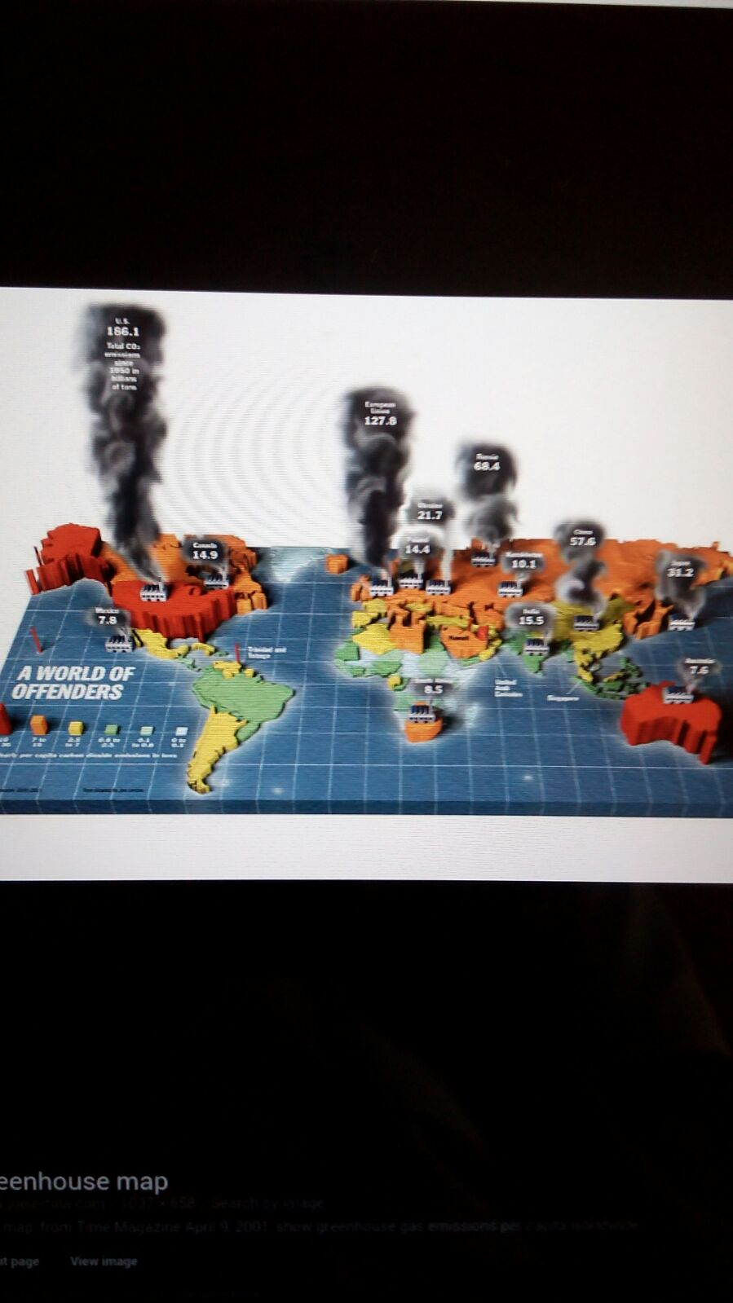

Slide 12
What's Cooking Up Our Planet?
Greenhouse gas emissions ....
Carbon dioxide
Methane
Nitrous oxide
Water vapour
Aerosols

Slide 13
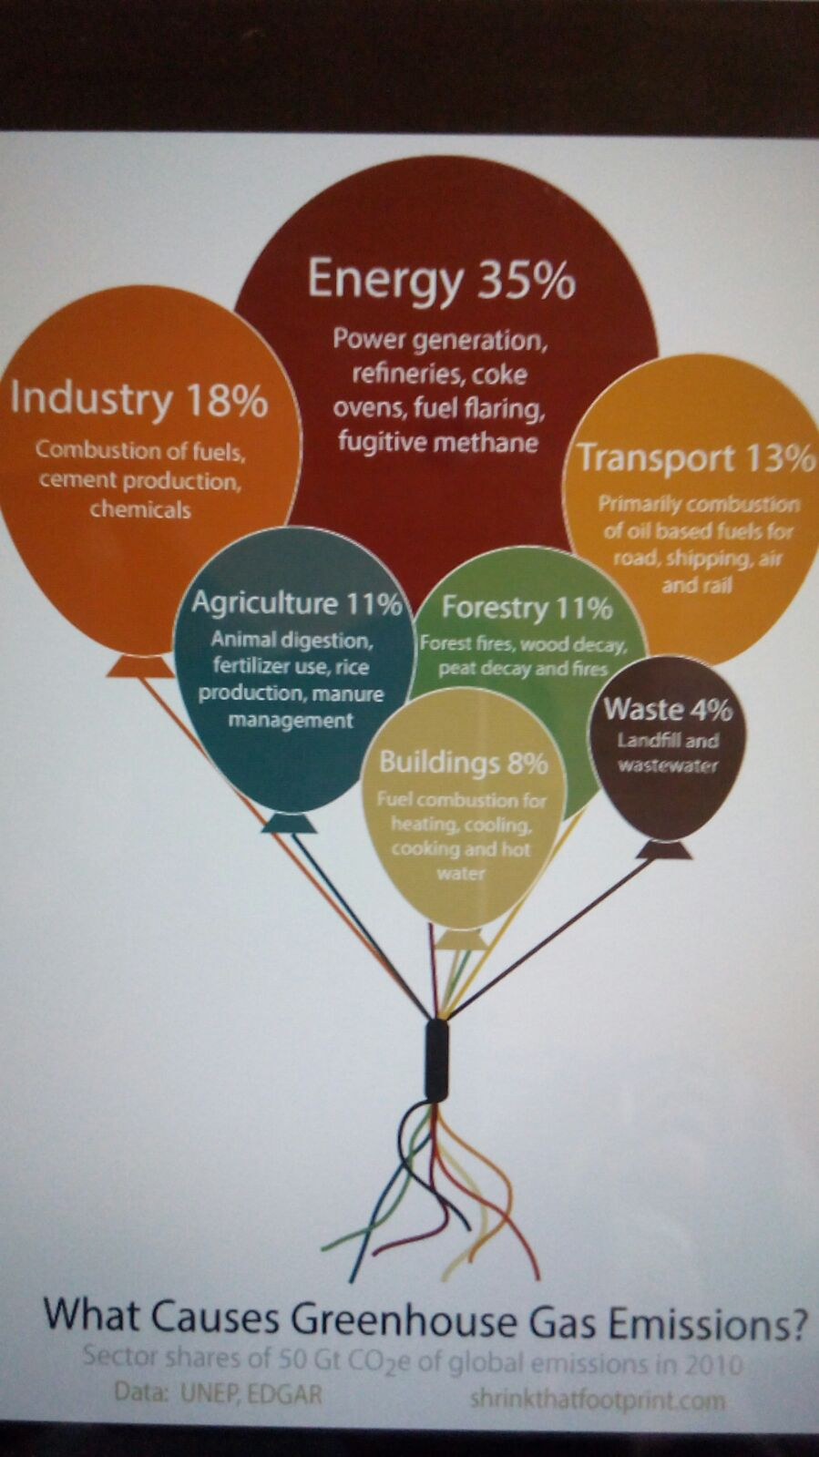

Slide 14
The Cooking Pots
Power Plants
Residential Buildings
Road Transport
Deforestation, Forest Degradation & Land Use Change
Energy Industry Processes & Losses
Commercial Buildings
Cement, Ceramics and Glass Production
Livestock
Iron & Steel Manufacture
Agricultural Soils
Chemical & Petrochemical Industries
Oil & Gas Production
Waste & Waste Water
Coal mining
Aviation

Slide 15
Greenhouse gas emissions
Energy production…the Chief source …mainly through production of fossil fuels
Fossil fuel…hydrocarbons that are formed from the remains of dead animals and plants.
Energy is bedrock to our vital needs…food, clothing, shelter, transport, etc
In developing countries majority of the people still live in abject “energy poverty” lacking electricity and heat…to improve life and the economy
Incumbent on both developing and developed countries to strategize to reduce/eliminate completely use of fossil fuels as energy source.
Way forward… embrace renewable energy sources, e.g. wind, solar, etc.

Slide 16
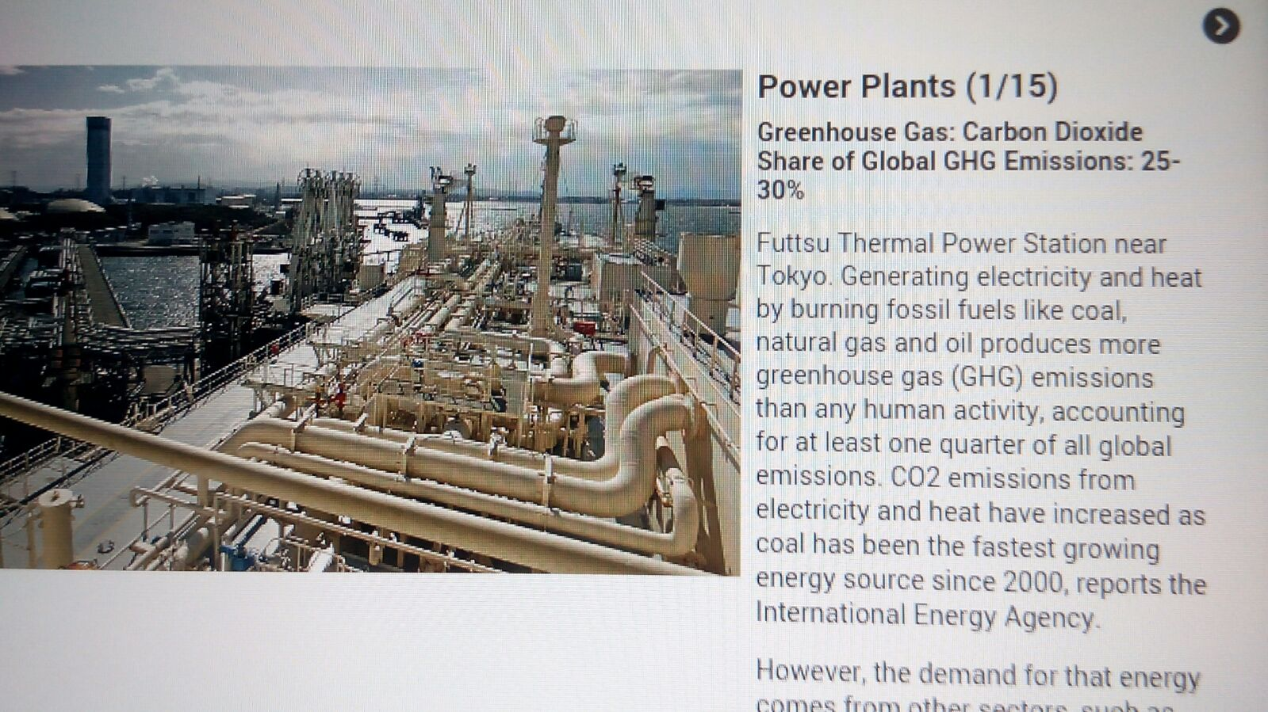

Slide 17
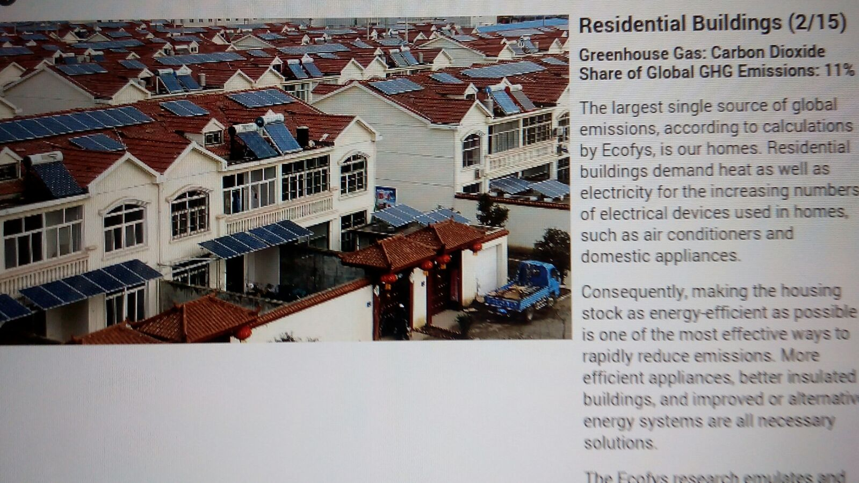

Slide 18
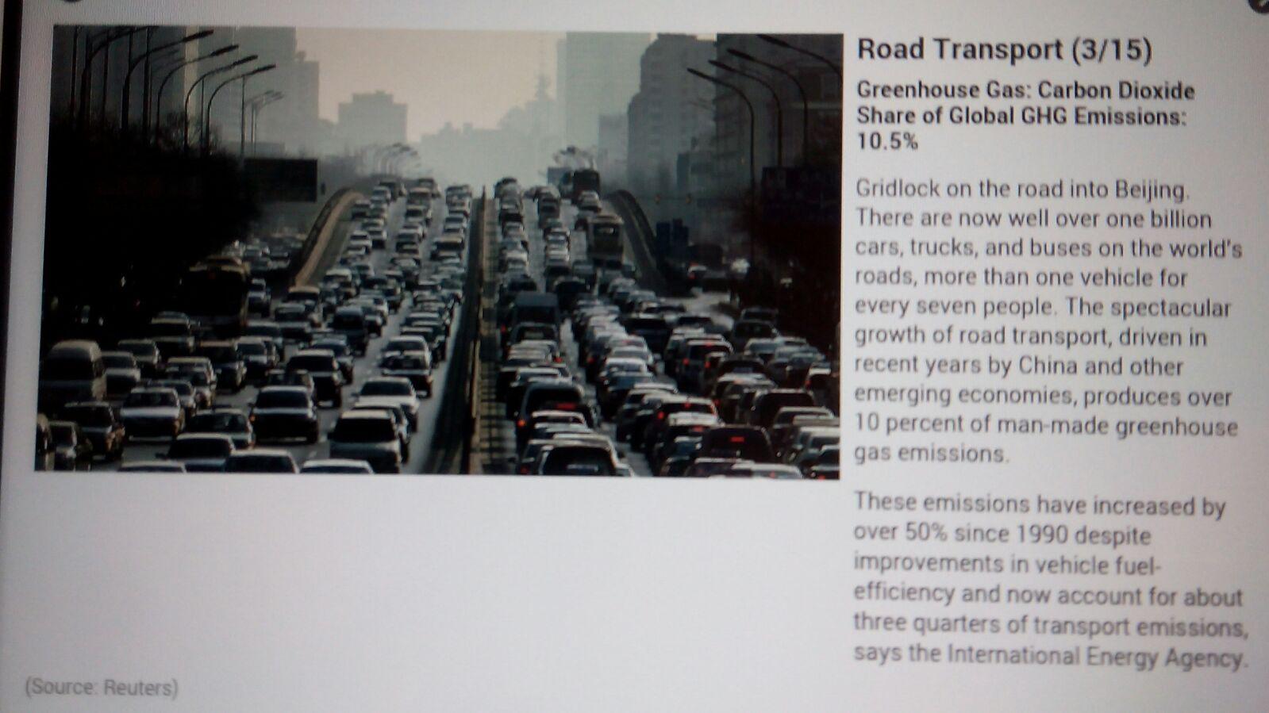

Slide 19
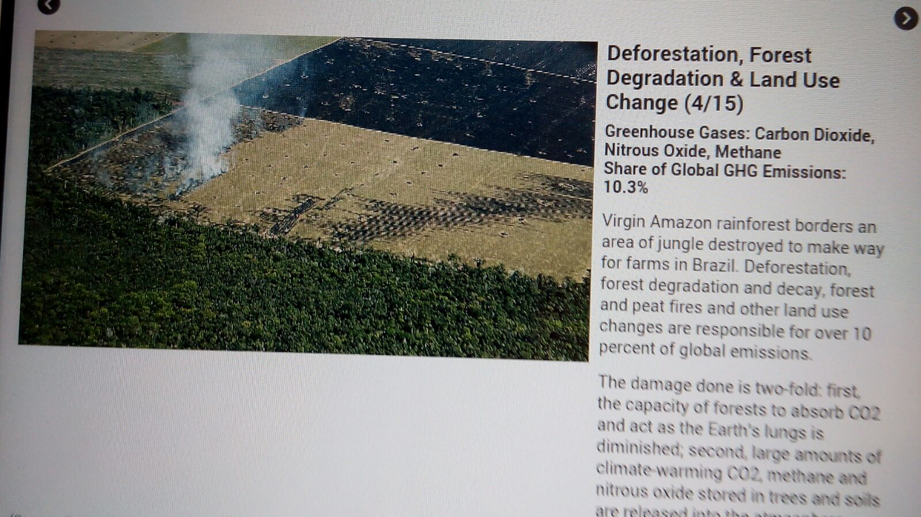

Slide 20
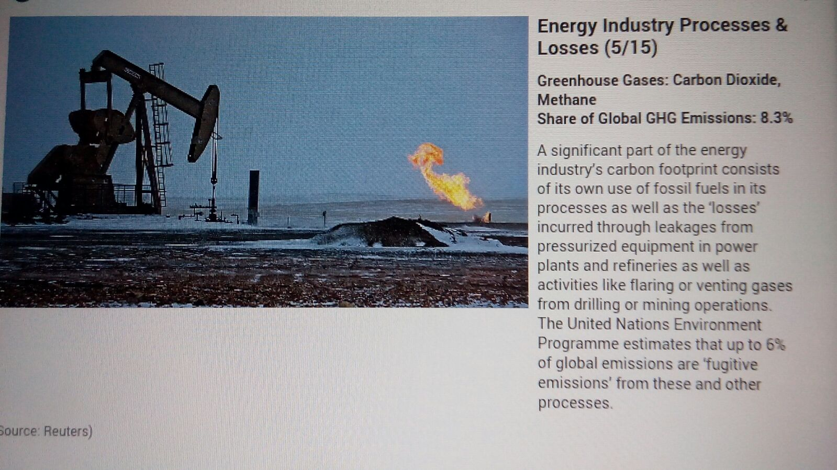

Slide 21
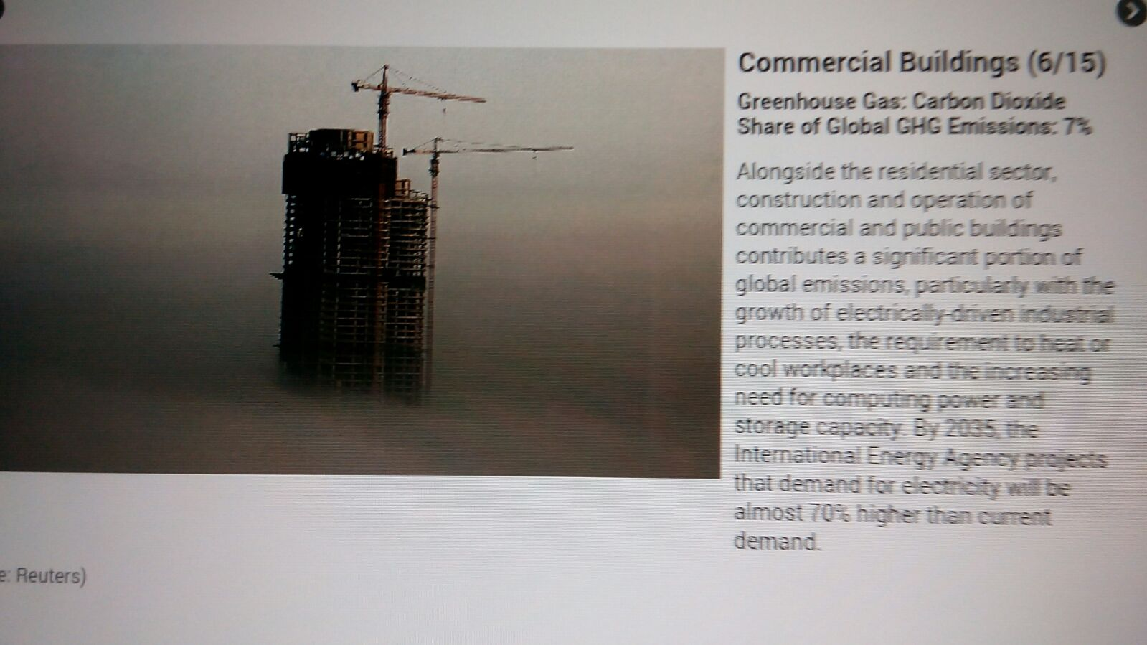

Slide 22
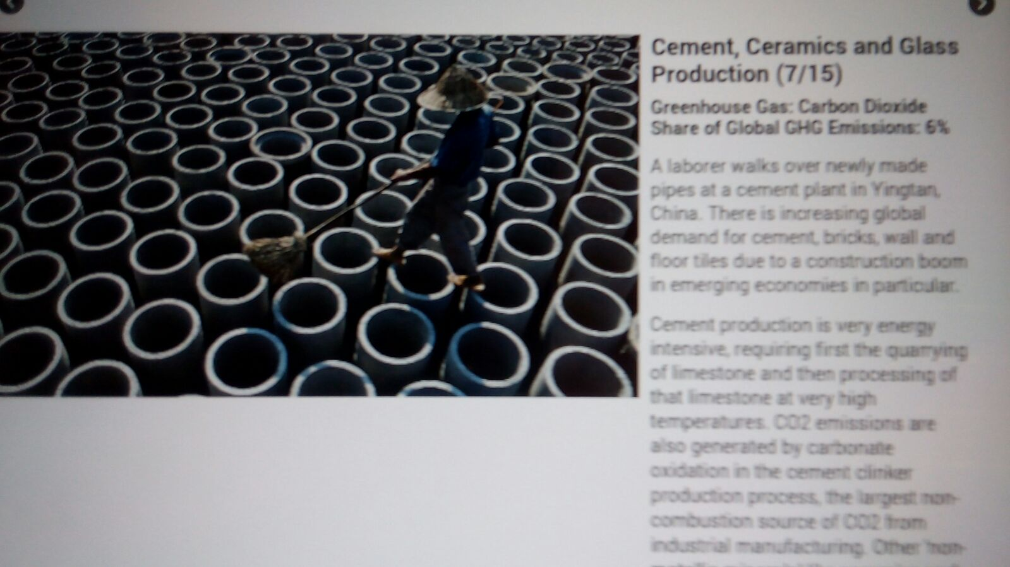

Slide 23
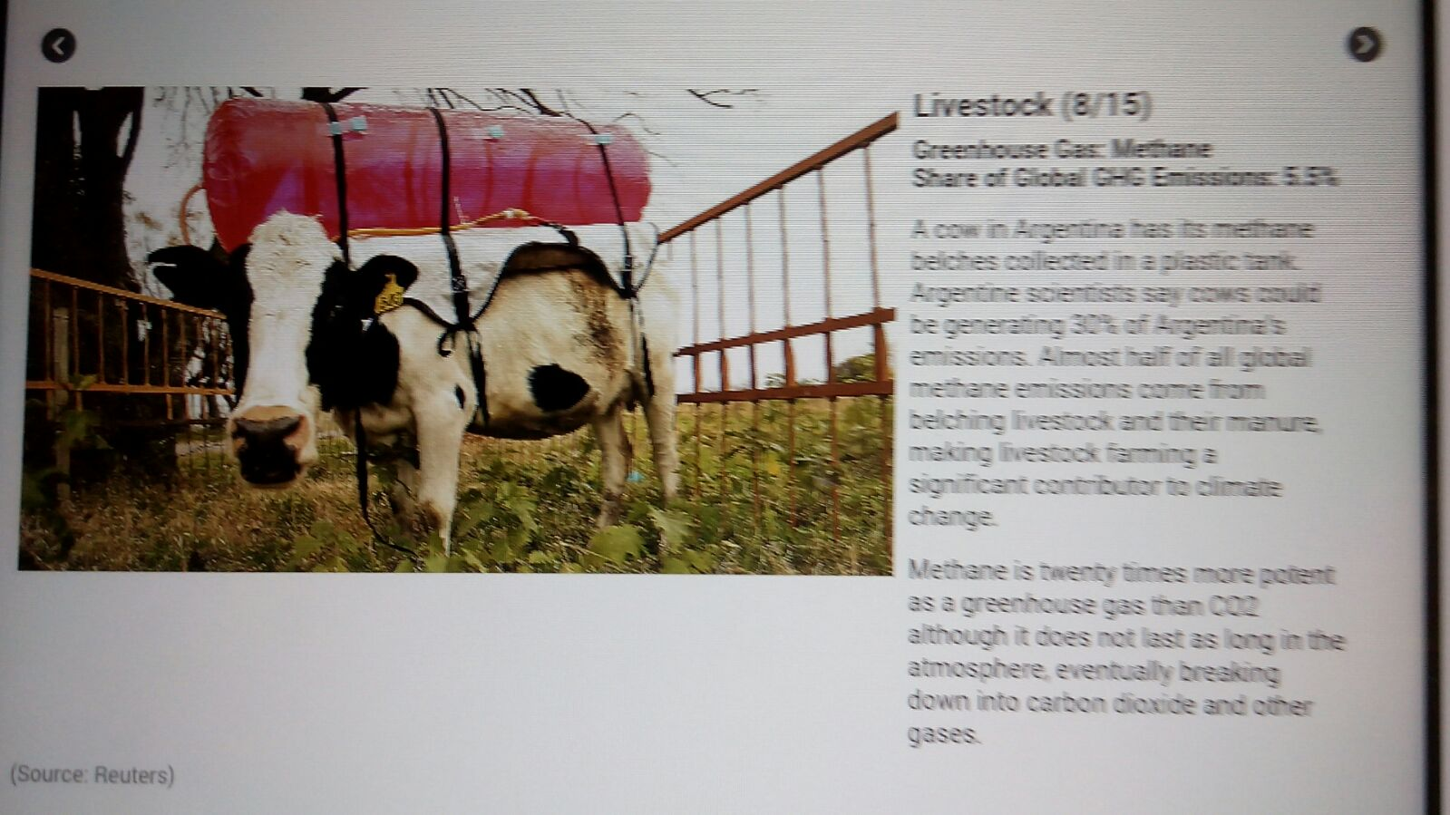

Slide 24
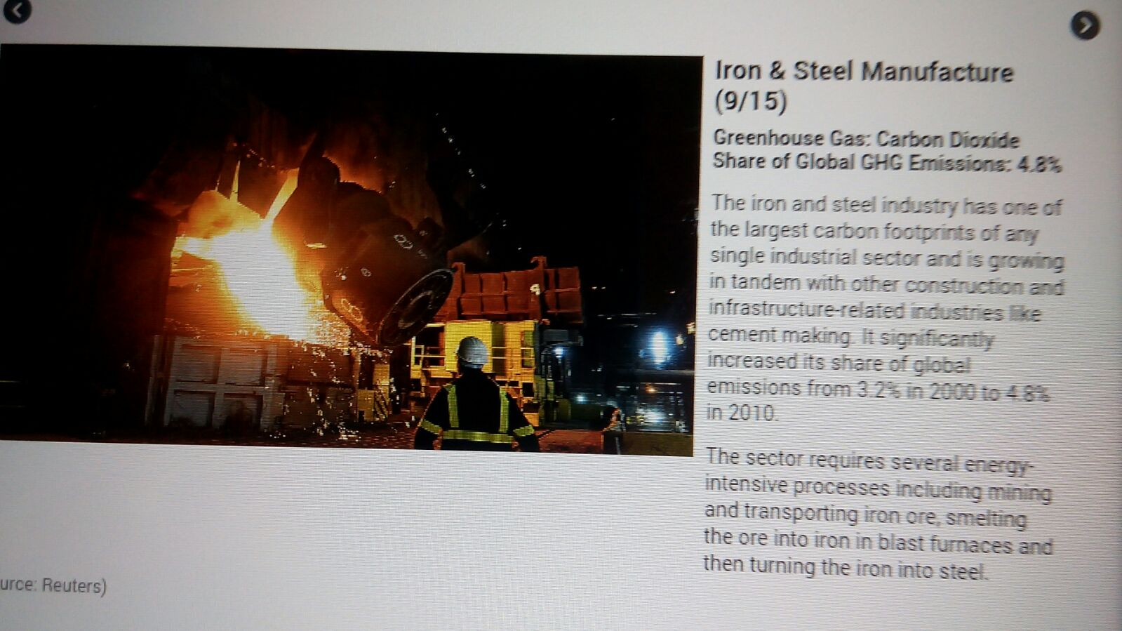

Slide 25
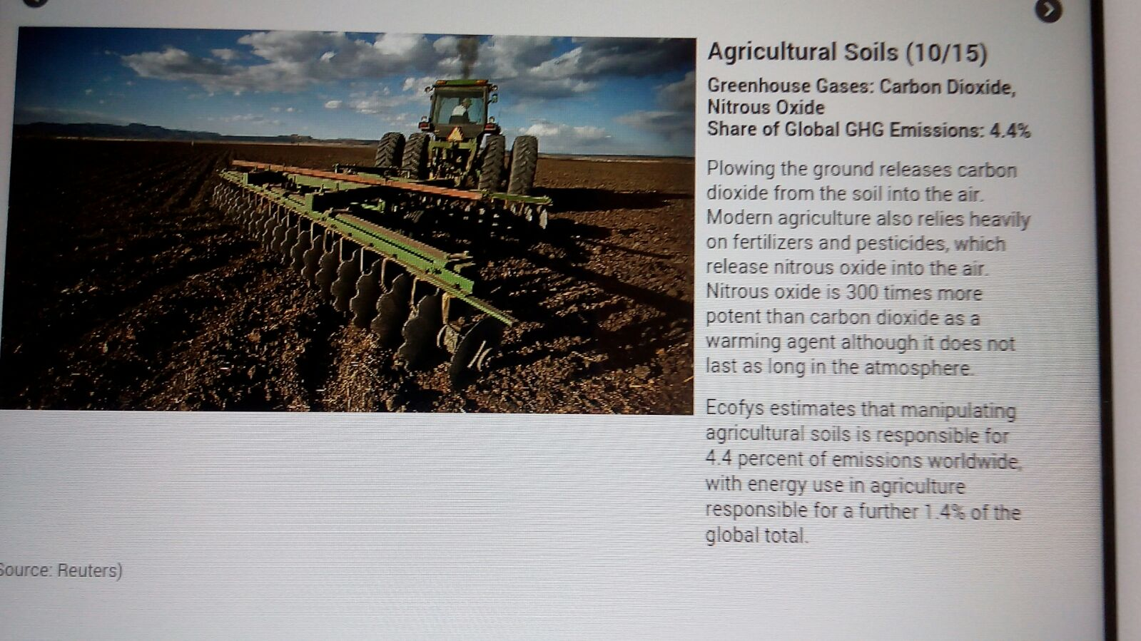

Slide 26
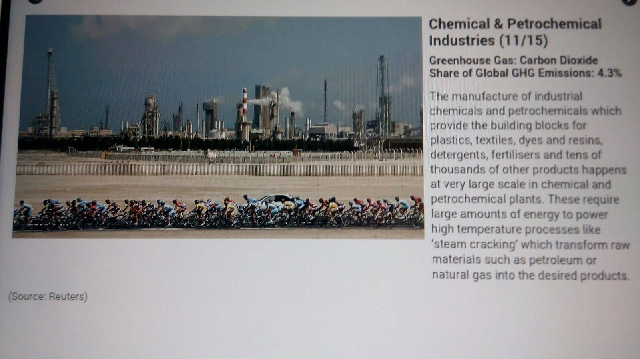

Slide 27
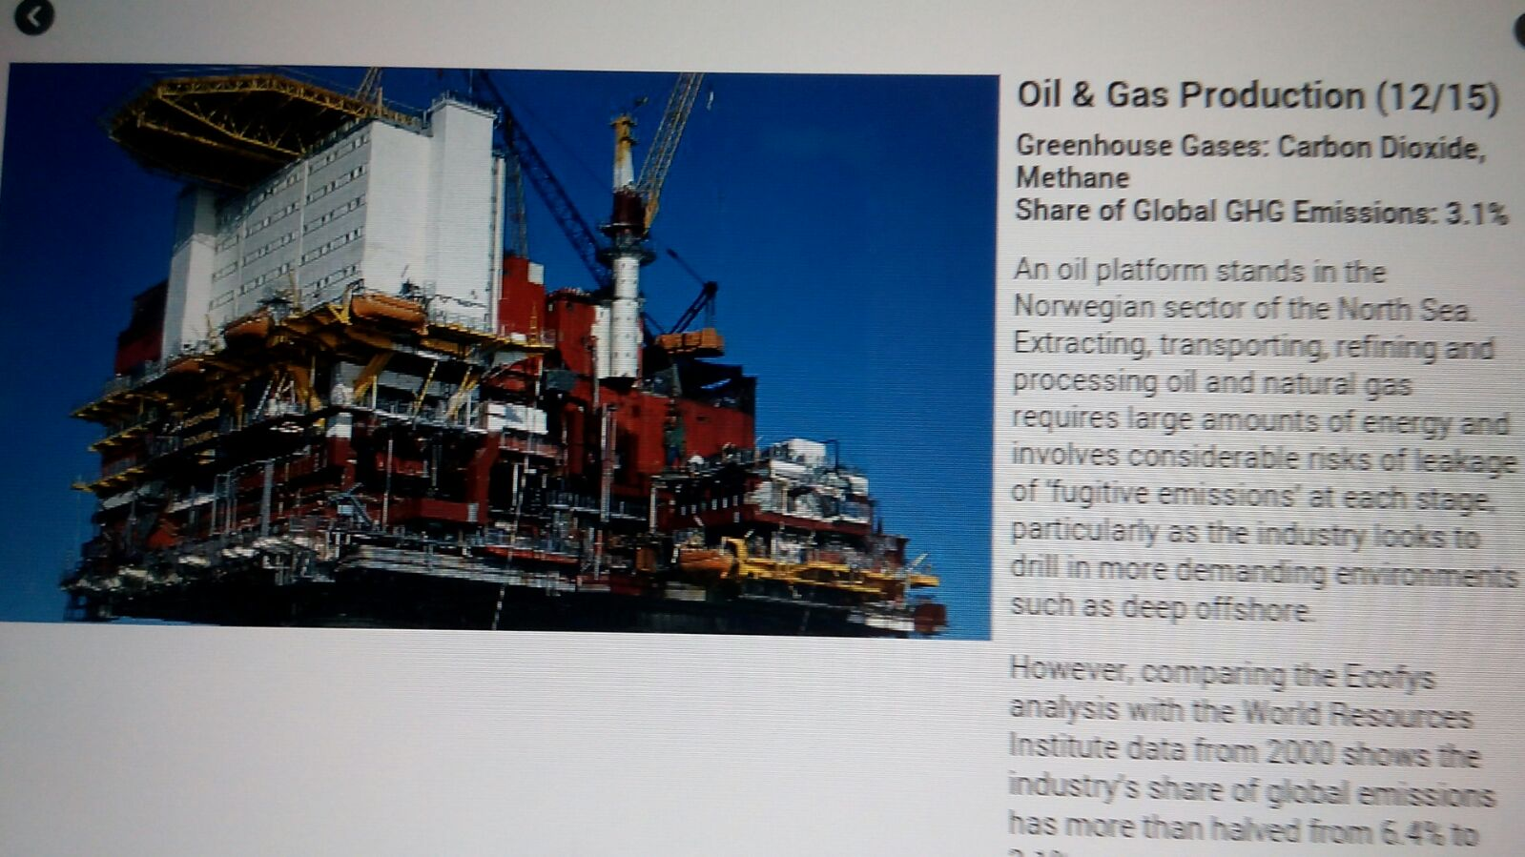

Slide 28
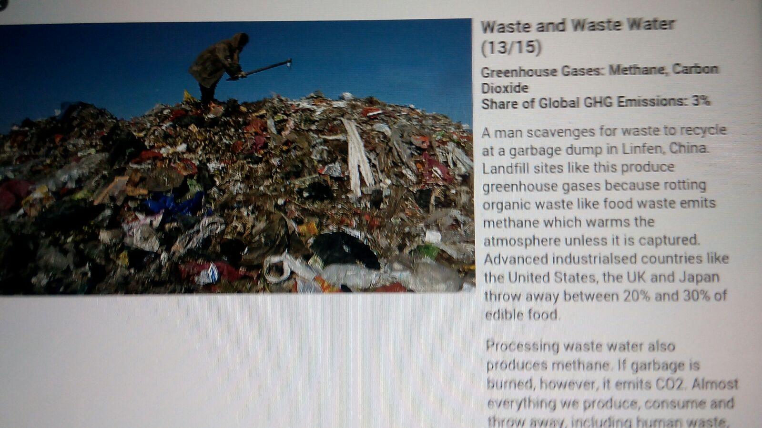

Slide 29
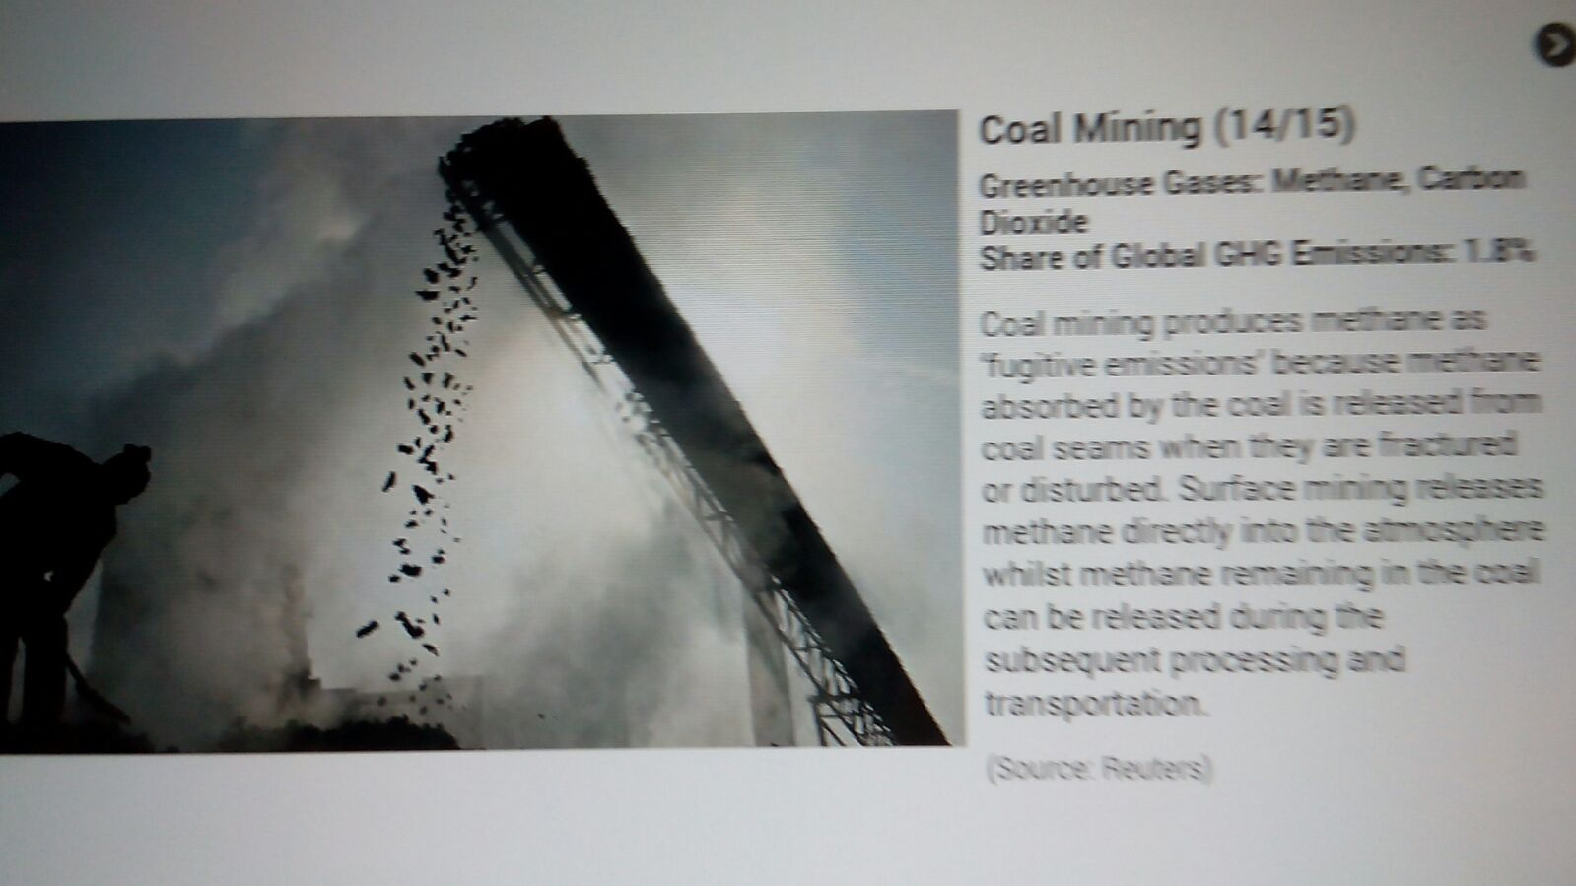

Slide 30
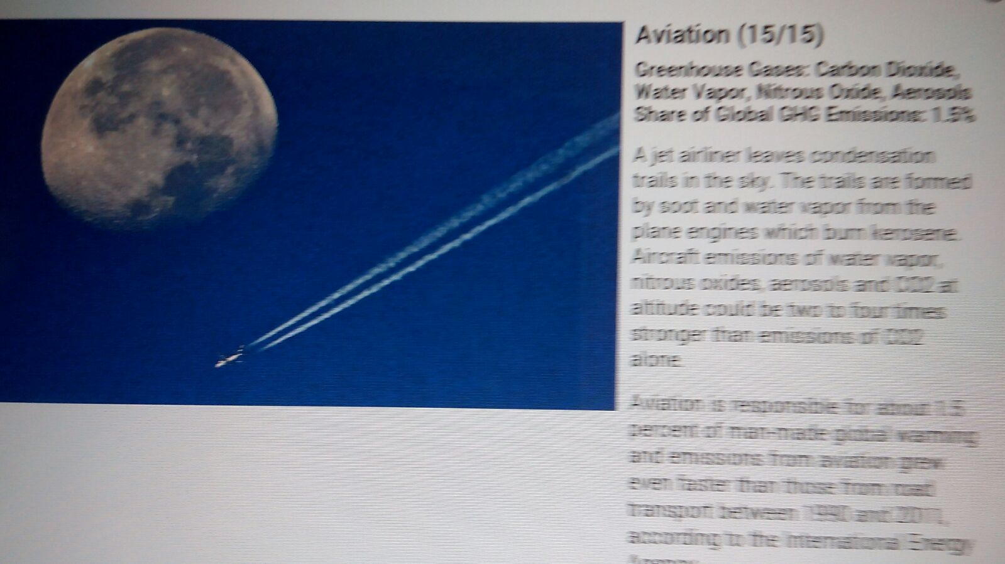

Slide 31
Do the needed...Cut greenhouse gas emissions
Taking the bull by the horn..to keep global temperature rise below 2 degree centigrade
Adopting a Trajectory A or the Trajectory B approach
Discard business-as-usual approach
Urgent need for behavioural and lifestyle changes

Slide 32
Trajectory A...Business-as-usual
Existing strategies to reduce greenhouse gas emissions, such as...
Developing cleaner technologies and improving efficiency
Inherent inadequacy….i.e.
Trends of increased consumption
Role of technology in providing for this demand
Technological and managerial improvements…do not necessarily ensure achieving zero emissions

Slide 33
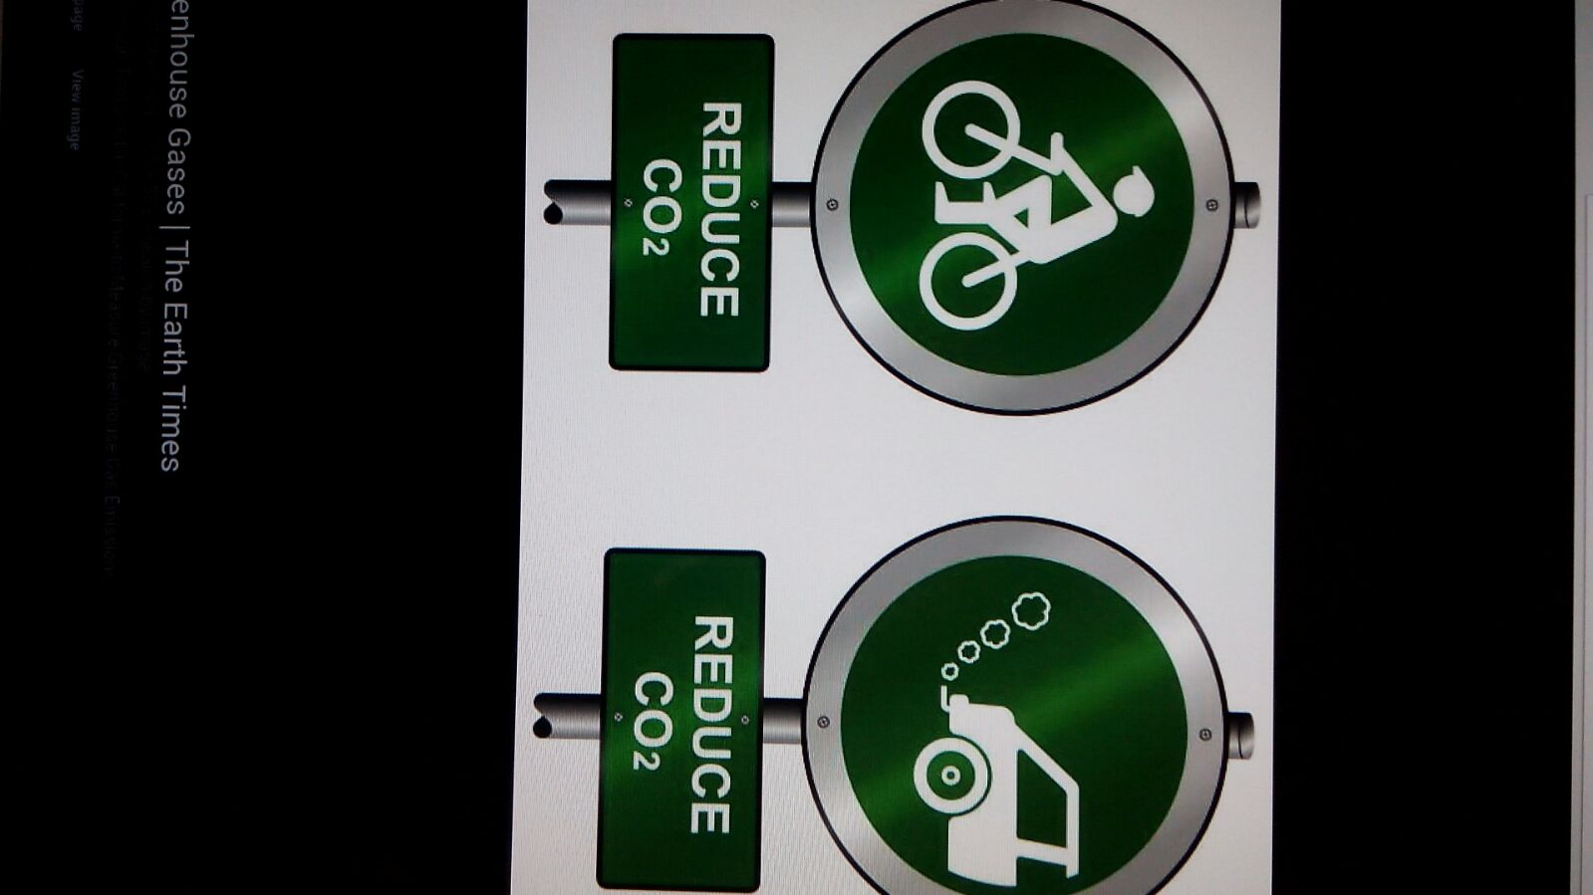

Slide 34
Trajectory B...Changing Lifestyle
Technological developments(TD) alone not enough to mitigate climate change
TD do not address trends in our consumption patterns inherently greenhouse gas intensive
Our society is addicted to oil, coal and other fossil fuels
Extreme preferences for unsustainable lifestyle and consumption patterns
Changing to sustainable lifestyle is the needed lifeline to curb the threats posed by climate change.
We need renewable energy to drive this new way of life.

Slide 35
Renewable Energy
Mitigate GHGs through shift from oil and coal to renewable energy sources…wind turbines, solar panels, hydro dams, etc.
The good news is…enough sunshine reaches the Earth in two hours to meet the world’s energy needs for a year.
Renewable energy source is defined as “a source of energy that is replaced by a natural or carefully controlled process at a rate that is equal to or faster than the rate at which the resource is being consumed”.
Unfortunately we are not yet able to harness this tremendous amount of energy to oust global dependence on fossil fuels once and for all.

Slide 36
Making the Right Energy Choices
TO MEET OUR CURRENT AND FUTURE ENERGY DEMANDS IN A WAY THAT WILL NOT HARM THE ENVIRONMENT………………..
WE SHOULD PICK ONE OR THE OTHER OF THESE TWO CHOICES:
Use energy from renewable sources such as, sun, wind
OR
Use energy in a more efficient and wise way.

Slide 37
Challenges posed
Countries with high carbon footprints may want to continue in their path of consumption;
Those with lower carbon footprint may want to increase their economic activities and develop further.
It is incumbent on the international community to explore and use more renewable energy… as best solution for all.
Key objective…aiming for a fairer carbon lifestyle for everyone.

Slide 38
Renewable Energy…predictions
According to scientists, the world can get all the energy it needs from renewable sources… sun, wind, water, biomass, geothermal, etc ‘within a few decades, making oil and coal nearly unnecessary’.
UNEP/UNESCO…predictions…many future careers, such as those in renewable energy and technology sectors, will help shape a green economy, based on sustainable, accessible and clean energy solutions.
UNESCO’s Global Renewable Energy Education and Training Programme…is helping to develop these careers in many developing countries.

Slide 39
Changing Lifestyle [1]
Existing consumption pattern based on assumed unlimited availability of natural resources
Globalisation of consumption and production of goods/international trade
Pressures on the environment and global climate
Growing population, incomes...New lifestyle and consumption preferences/aspirations

Slide 40
Changing Lifestyle [2]
Fall-out ...increased demand for:
New food diets
More cars
More electrical and electronic gadgets
GLOBALISATION BOOSTING TRADE IN THESE COMMODITIES
Need to ensure global consumption is more sustainable and environment /climate friendly

Slide 41
Changing Lifestyle [3]
To avoid increasing level of damage caused by climate change and greenhouse gas emissions
Greenpeace has proposed that...
Consumption is reduced in high-income countries and,
Slowed down in developing countries
Lifestyle changes possible with regard to all our consumption patterns...Greenpeace

Slide 42

Low Carbon Footprints

Slide 43
A low-carbon lifestyle
Creates less carbon dioxide and greenhouse gases and ensure:
Renewable sources of energy
Less travel, especially by air and car
More efficient use of energy in appliances and homes/offices
More energy efficient production of food and other goods
Fewer and more locally produced consumer goods.

Slide 44
Report of the Marrakech Task Force on Sustainable Lifestyles:
Rethinking our ways of living
Living in harmony with our natural environment
At home and at work our choices on:
Energy use
Transport
Food
Waste
Communication
How we socialize
Exchange
Share
Educate, and
Build identities
Contribute towards building sustainable lifestyles

Slide 45
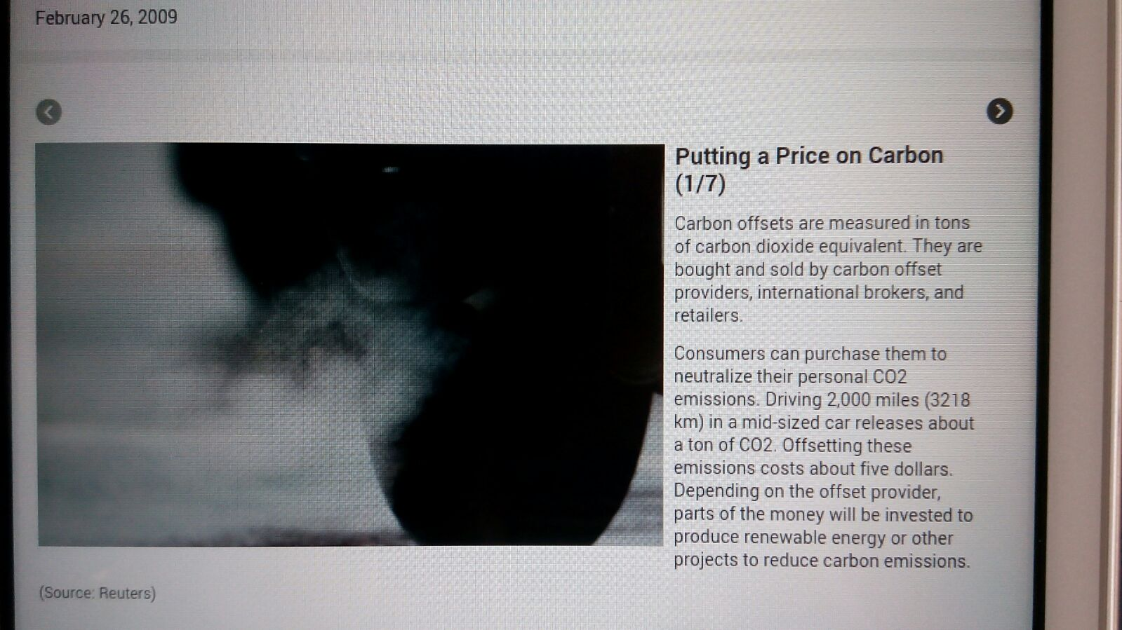

Slide 46
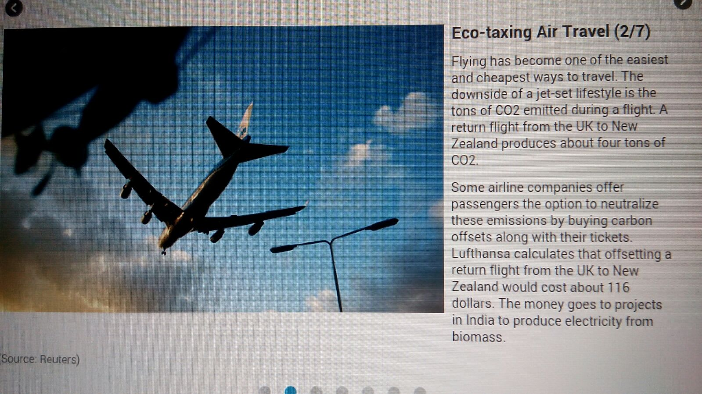

Slide 47
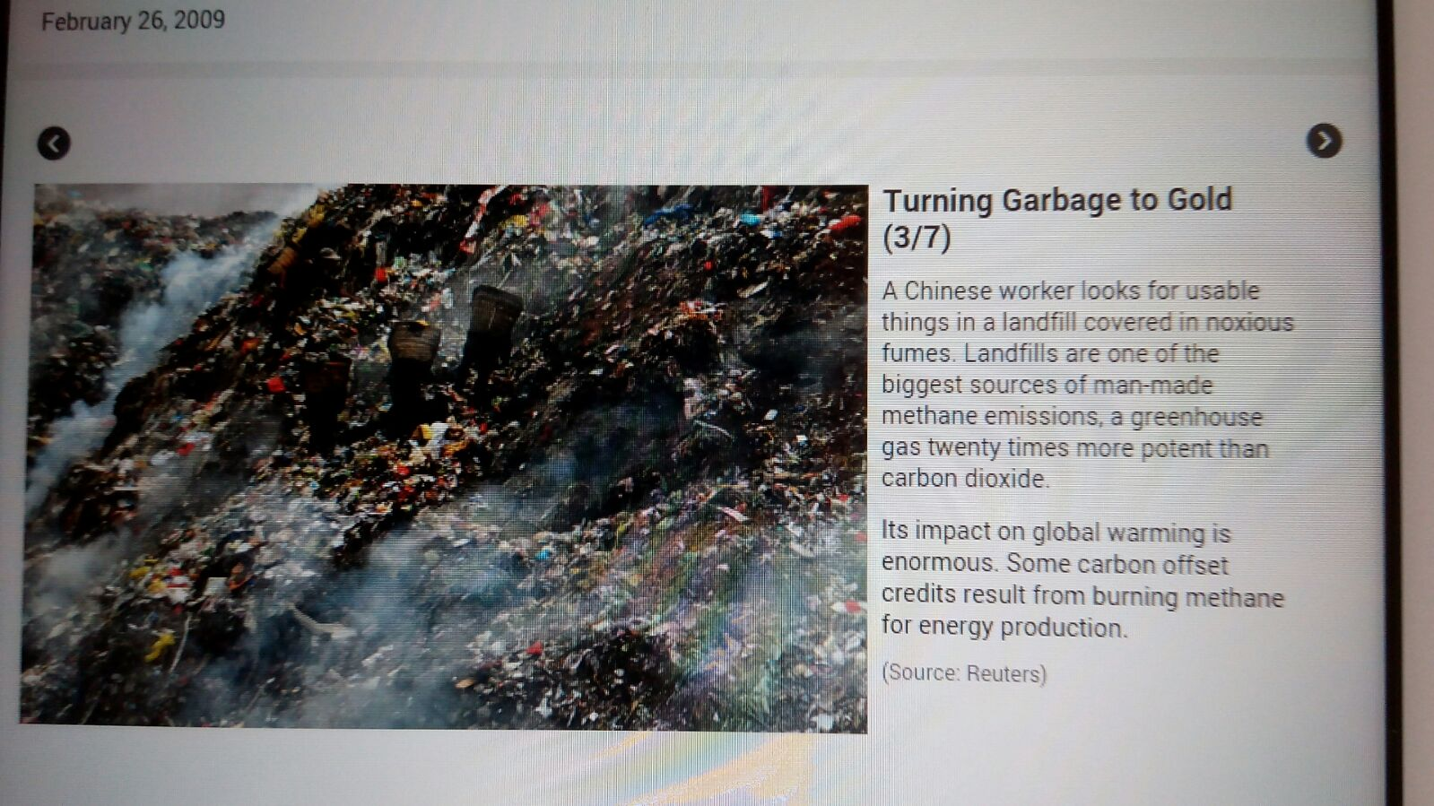

Slide 48
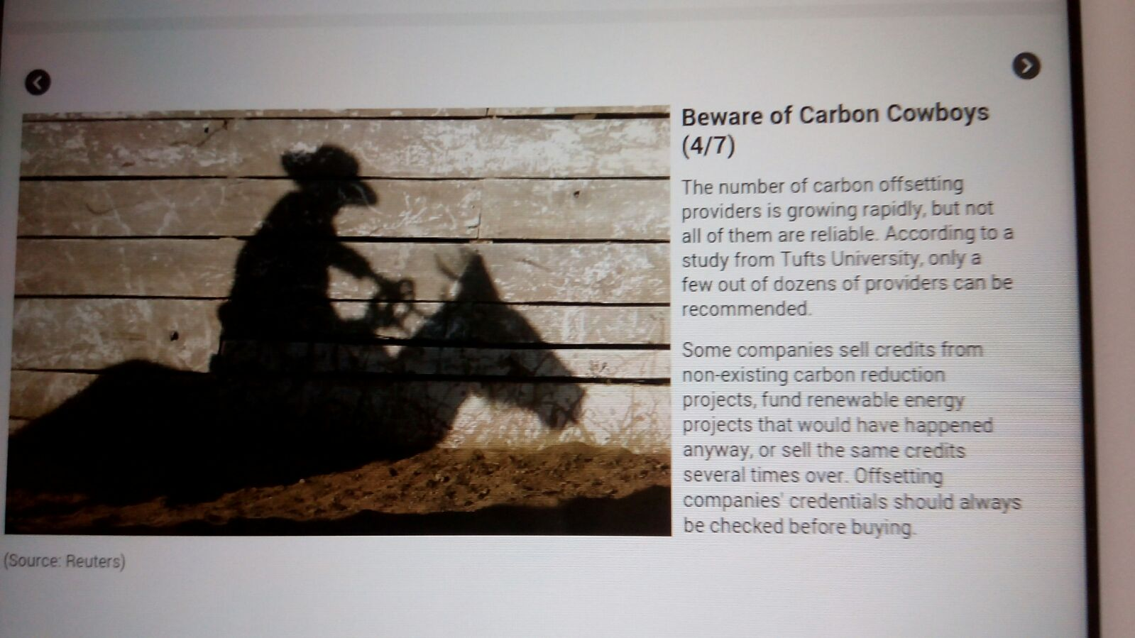

Slide 49
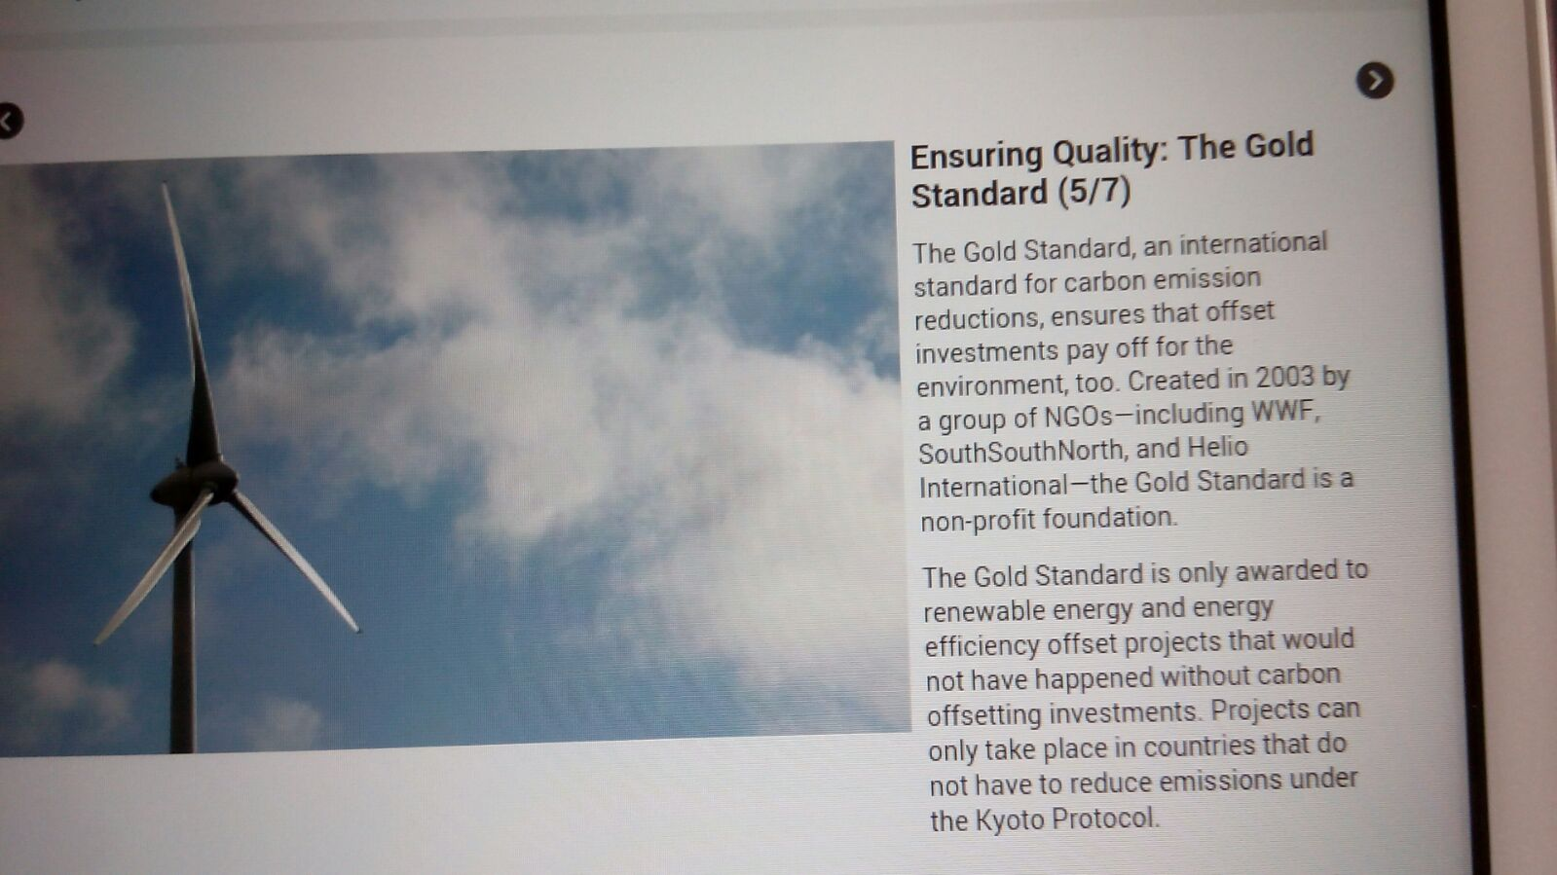

Slide 50
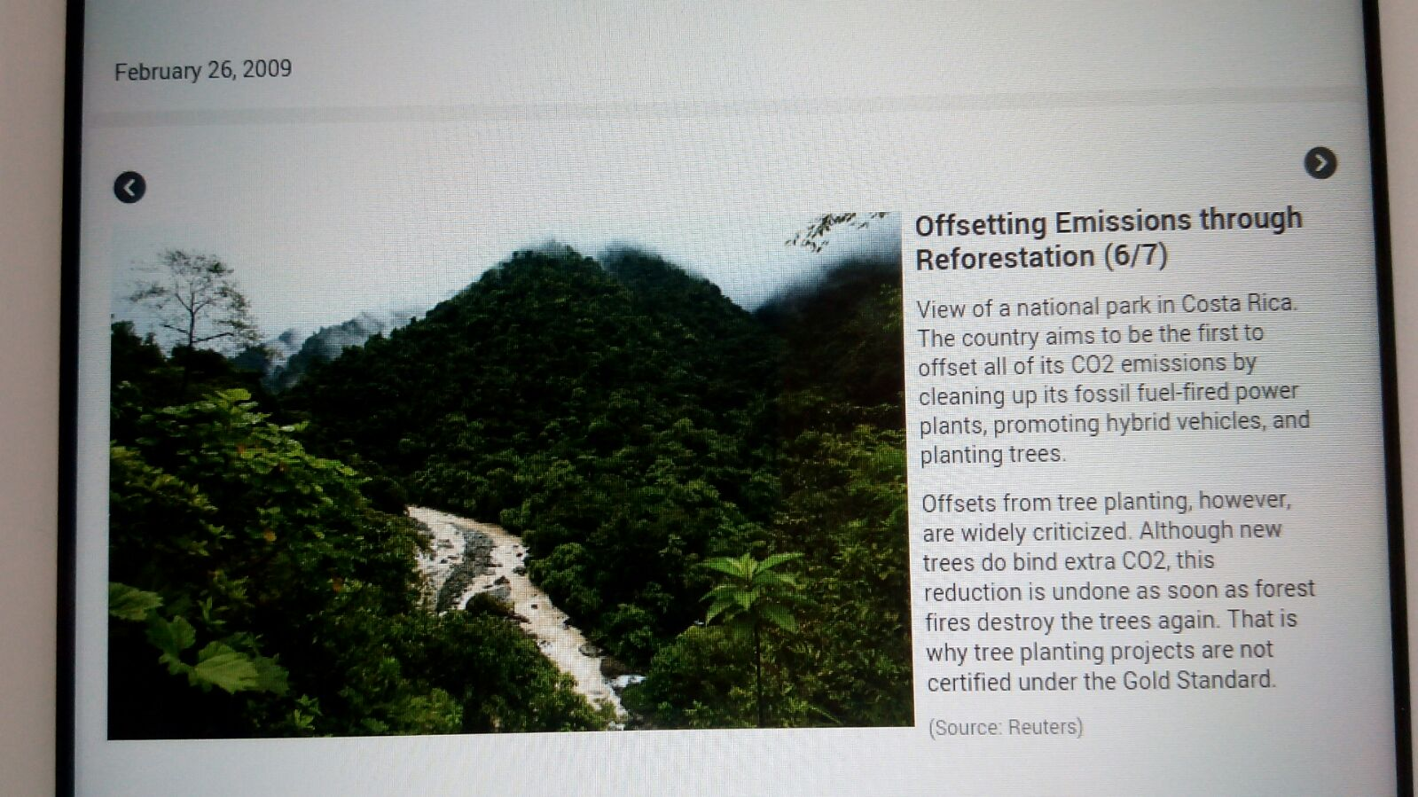

Slide 51
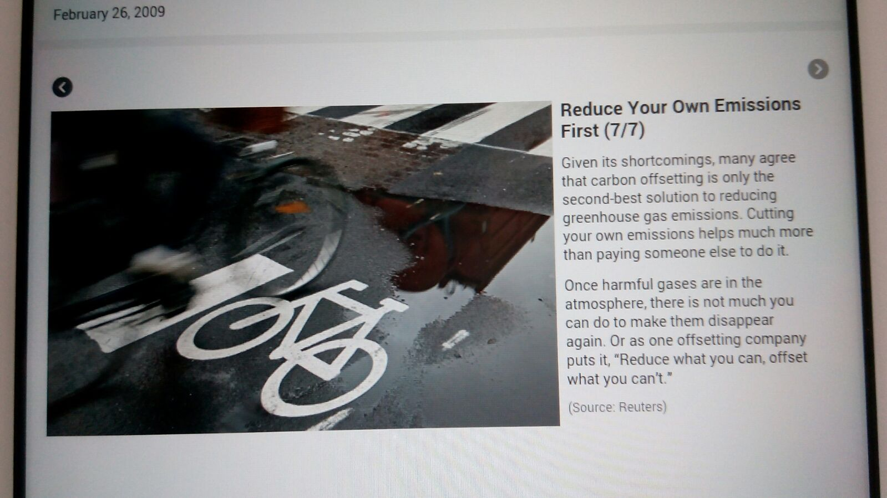

Slide 52
Transportation
Promote use of low-carbon vehicles
Reduce amount of kilometres driven...by
Reducing the need for transport
Shifting people to non-motorised transport
Changing transport modes for people and freight to less emitting means e.g. rail and public transport instead of cars, trucks and planes

Slide 53
Meat and dairy consumption
Meat is a very carbon-intensive commodity
Greenpeace proposes a decrease in average worldwide consumption of animal products
Advantage for climate and reduce negative health impacts of meat consumption

Slide 54
Electrical and electronic appliances
Increase in households' electrical and electronic gadgets
Query...the necessity of most of these????
Re-evaluating the way we use electricity
Do we really need our electrical and electronic gadget or whether we can do without it
Reducing electricity use through implementing policies and awareness raising

Slide 55


Slide 56
Is it Do-able???
Certainly!
The challenges associated with climate change give high consumers of goods, products, fossil fuel energy, etc at global national, state, community and individual /personal scales good reasons to embrace the advantages and change to a low-carbon economy.

Slide 57
Advantages of a low-carbon lifestyle include:
Being creative and innovative to improve our lives, health, wellbeing and environment
Exploring ways of working and living together
Setting an example for others
Improving skills of working with the natural environment
Caring for less advantaged people and being fair to all.

Slide 58
Advantages of low-carbon
Having concern for future generation and the well-being of our families
Being well prepared for the future
Securing local supplies and being self sufficient
Experiencing fewer emergencies and disasters
Experiencing less forced migration due to sea level rise and extreme changes of climate

Slide 59
Conclusion
The Environment and the energy need of man are “bedfellows” …vital for the sustenance of a “good life” on Earth.
These two must not be “strange bedfellows” for us to have the “good life” here in this one and only environment that sustains life.
Good life requires good health, happiness and prosperity.
Climate change poses a challenge to the realization of the good life we desire.
The glaring challenges posed by climate change gives high consumers of energy strong reasons to change to low carbon lifestyle.
TURN OFF THE HEAT COOKING THE PLANET now…with sustainable lifestyle.

Slide 60


Slide 61
Concluding Reflections (1)…
Put a frog in a vessel of water and start heating the water.
As the temperature of the water rises, the frog is able to adjust its body temperature accordingly.
The frog keeps on adjusting with increases in temperature…
Just when the water is about to reach boiling point, the frog is not able to adjust anymore…
At that point the frog decides to jump out…
The frog tries to jump but is unable to do so, because it has lost all its strength adjusting with the rising temperature…
Very soon the frog dies.

Slide 62
Concluding Reflections (2)…
What killed the frog?
Many of us would say the boiling water…
But the truth is what killed the frog was its own inability to decide when it had to jump out.
We all need to adjust with people and situations, but we need to be sure when we need to take the rightful decision. Because no one else might get hurt at the end of the tunnel but you.

Slide 63
Concluding Reflections (3)…
There are times when we need to face the situation and take the appropriate action…
If we allow people to exploit us physically, mentally and emotionally or financially they will continue to do so…
We have to decide when to jump.
Let’s jump while we still have the strength.
#Inspired Network… 2nd November, 2015.

Slide 64
THANK YOU….
FOR LISTENING.

Slide 65
Refrences
Encyclical Letter, LAUDATO SI OF THE HOLY FATHER FRANCIS ON CARE FOR OUR COMMON HOME, (2015) The Holy See.
"Climate Change and Global Warming : Have we Crossed the Tipping Point?", Okorodudu Fubara, M.T., (2014), Port Harcourt
"15 sources of greenhouse gases ", Allianz Knowledge, (2014

Slide 66
References
"Climate Change: Issues in Law and Governance ", Okorodudu Fubara, M.T. (2013), Ibadan.
"Cultural Responses to Climate Change: Cultivating Lifestyle Activism through Alternative Knowledge Productions", Dean, M., (2013).
Intergovernmental Panel on Climate Change (Fourth/Fifth Assessment Reports)

Slide 67
References
"Africa, Climate Change and 'Good Governance ': Key Research Capacity and Networking Needs", Okorodudu Fubara, M.T., (2013) Accra, Ghana.
UNEP, Youth Xchange: Climate Change and Lifestyles Guidebook, UNEP and UNESCO, (2011).
"Impacts of Oil Drilling and Climate Change: Double Jeopardy in the Niger Delta", Okorodudu Fubara M.T. (2010) Washington D.C..

Slide 68
References
Cities, Climate Change and Multilevel Governance, Corfee-Morlot,J, et Al., (2009) OECD.
"Oil & Ecological Disruptions in the Niger Delta: Challenges & Opportunities for Sustainable Development ", Alaibe, T. (2008) Abuja.
The Greenpeace Climate Vision, Background Note No. 8.

